Slide 1


SEMINAR PRESENTATION
Digital Image
Fundamentals
An introduction to how computers capture, process, and understand images.
Introduction To Digital Image Fundamentals
Notes:
Welcome the panel. Introduce the topic in one line: this seminar is about how computers capture, process, and understand images, starting from the basics and building up to how pixels relate to each other.

Slide 2
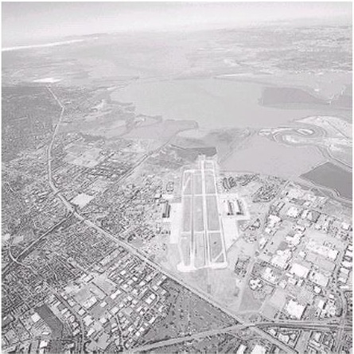
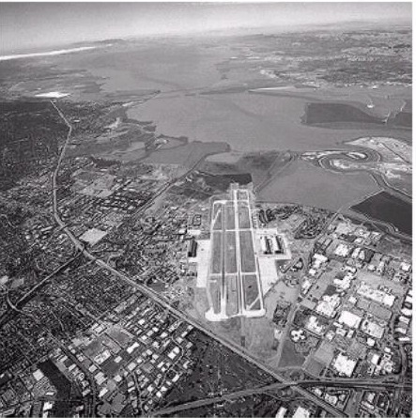
THE BASICS
What Is Digital Image Processing?
A computer works with pictures, the way a person would
It can improve an image, clean it up, or study it
Every image is really a grid of tiny dots called pixels
Each pixel just stores a number for brightness and color
Original
Processed
A simple example: cleaning up and sharpening an aerial photo.
Digital Image Fundamentals
2 / 15
Notes:
Define DIP in plain terms: using a computer to work with pictures. Point out the pixel grid idea and the before/after example on screen.

Slide 3



THE BASICS
Why Do We Process Images?
Improve Quality
Extract Information
Automate Tasks
Remove noise, blur, and poor lighting so images look clear.
Detect edges, shapes, and objects hidden in the data.
Let computers recognize faces, read text, or spot disease.
In use since the 1920s — and still evolving with AI today.
Digital Image Fundamentals
3 / 15
Notes:
Walk through the three reasons quickly: quality, information, automation. Mention it is not a new field, it just keeps growing.

Slide 4

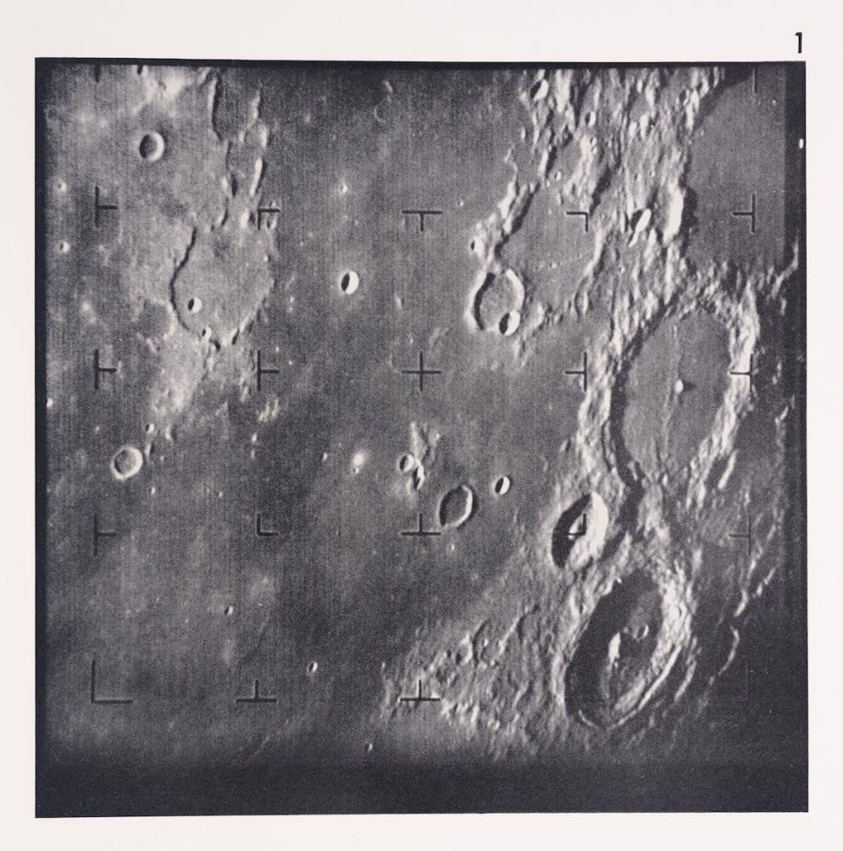
THE BASICS
A Quick Look at History
1920s
First images sent electronically, over telegraph lines
1960s
NASA uses it to study close-up photos of the Moon
1970s
Doctors use it to read X-rays and CT scans
1980s–90s
Factories use it for automatic inspection
Today
Powers face recognition, self-driving cars, and AI
1964 — NASA's Ranger 7 Moon image, made clearer with digital processing
Digital Image Fundamentals
4 / 15
Notes:
Give one or two history highlights out loud (telegraph images, NASA Moon photos) and let the timeline carry the rest.

Slide 5




THE BASICS
Main Steps in Digital Image Processing
Capture
Enhance
Restore
Segment
Recognize
Take the image with a camera or sensor
Improve contrast, sharpness, brightness
Fix noise, blur, or damage
Separate the object from the background
Label or identify what was found
Raw pictures go in one end; useful, meaningful information comes out the other.
Digital Image Fundamentals
5 / 15
Notes:
Name the five steps left to right, one short phrase each. Keep pace brisk, this is an overview slide.

Slide 6


REAL EXAMPLE
Seeing It In Action: Finding a Tumor
Original MRI
Clean Up
Segment
Identify
A scan with noise and unclear regions
Remove noise, sharpen structures
Separate the tumor from healthy tissue
Confirm and label the result
The same steps from the last slide — just applied to a real medical image.
Digital Image Fundamentals
6 / 15
Notes:
Reuse the exact same five ideas from the last slide, but now applied to a concrete case, an MRI scan. This shows the pipeline in action.

Slide 7


HUMAN VISION
How Human Eyes See
Light
Retina
Brain
Reflects off an object
Rods & cones sense it
Turns signals into sight
Rods sense brightness — especially useful in low light
Cones sense color, across red, green, and blue-ish ranges
The brain combines these signals into what we actually "see"
Digital Image Fundamentals
7 / 15
Notes:
Trace the flow: light hits the eye, retina senses it, brain interprets it. Briefly mention rods vs cones.

Slide 8
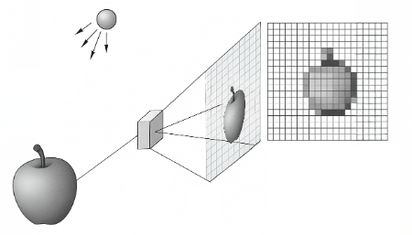
HUMAN VISION
How a Digital Camera "Sees"
Light passes through a lens onto a sensor
The sensor turns light into electrical signals
Color filters (Red, Green, Blue) separate the colors
Signals become numbers — a digital image
Light → lens → sensor → a pixelated digital image
Digital Image Fundamentals
8 / 15
Notes:
Mirror the eye slide: light, lens, sensor, digital numbers. Point at the pixelated apple in the diagram as the payoff image.

Slide 9
HUMAN VISION
Eye vs. Camera: Quick Comparison
Feature | Human Eye | Digital Camera
Light Receiver | Retina (rods & cones) | Image sensor (CCD / CMOS)
Color Sensing | 3 cone types (S, M, L) | Red / Green / Blue filters
Processing | Brain & visual cortex | Onboard image processor
Output | What we perceive | Numbers, e.g. 0–255 per pixel
Both systems turn light into meaning — just with very different hardware.
Digital Image Fundamentals
9 / 15
Notes:
Read the table row by row if helpful, or simply say: same job, different hardware.

Slide 10



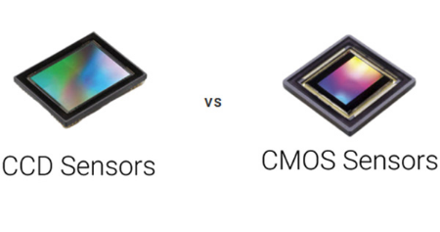
IMAGE CAPTURE
Capturing Images: Types of Sensors
Single Sensor
Line Sensor
Array Sensor
Moves point-by-point across the scene. Precise, but slow.
Scans one strip at a time — e.g., flatbed scanners.
Captures the whole image at once. Used in modern cameras.
The two most common array-sensor chips found inside cameras
Digital Image Fundamentals
10 / 15
Notes:
Name the three sensor types and point to the CCD/CMOS photo as the real-world example of an array sensor.

Slide 11

DIGITIZATION
From Light to Numbers: Sampling & Quantization
Sampling
Quantization
Turns a continuous scene into a fixed grid of picture elements — pixels.
Turns each pixel's brightness into a number — for example, 0 to 255.
Digital Image Fundamentals
11 / 15
Notes:
Explain sampling as space (the grid) and quantization as brightness (the numbers). Point to the two visuals.

Slide 12


DIGITIZATION
The Full Digital Imaging Pipeline
Scene
Sensor
Analog Signal
Sampling &
Quantization
Digital Pixels
Every stage before this turns light into a signal. Everything after this point is just math on numbers.
Digital Image Fundamentals
12 / 15
Notes:
Walk left to right through the five-node pipeline; this slide ties every earlier idea together in one line.

Slide 13
PIXEL RELATIONSHIPS
Pixel Neighbors: What's Next to a Pixel?
Computers need clear rules for "next to"
Straight neighbors (N4): up, down, left, right
Add the 4 corners too, and you get N8
This matters for tracing edges and finding shapes
NW
N
NE
W
p
E
SW
S
SE
4 straight neighbors — N4
+4 corners = 8 neighbors — N8
Digital Image Fundamentals
13 / 15
Notes:
This is the start of the seminar's core topic. Explain that computers need explicit neighbor rules, then point to N4 vs N8 on the grid.

Slide 14
PIXEL RELATIONSHIPS
Connectivity & Distance: Linking Pixels
Pixels link into shapes when they’re neighbors and match in value
Using two rules together (e.g. 4 & 8) keeps shapes solid — no gaps, no leaks
Three Ways to Measure "How Far"
Euclidean
City-Block
Chessboard
True straight-line distance
Only straight steps count
Diagonal steps count the same
Digital Image Fundamentals
14 / 15
Notes:
Keep this slide light: connectivity keeps shapes solid, and there are three ways to measure distance between pixels, shown as three shapes.

Slide 15




SUMMARY
Key Takeaways
Neighbors
Every pixel needs clearly defined neighbors
Connectivity
Consistent rules link pixels into objects
Paths
Connected pixels form traceable shapes
Distance
Different metrics measure "how far" differently
Thank You
Questions & Discussion
Notes:
Recap the four pillars in one sentence each, then thank the panel and invite questions.

